Slide 1
Digital Filmmaking
Telling Stories through Technology

Slide 2
Introductions
Name (or your preferred name)?
What is the most memorable film / video you’ve watched recently? What do you like about it and why?
Do you have experience using a camera or editing videos? (It’s okay if you don’t!)
What do you expect to learn from this class?

Slide 3

Introductions
Jiwon Shin
Resident Research Fellow,
Interactive Media Arts (IMA), NYU Shanghai
Email: jiwon.shin@nyu.edu
Website: http://jiwonshin.com
Always feel free to email if you have any issues or questions. All emails will be answered within 24 hours

Slide 4
Class Website:
js6450.github.io/DigitalFilmmaking

Slide 5
What is a STORY?

Slide 6
What is STORYTELLING?

Slide 7
The Technology of Storytelling, Joe Sabia

Slide 8
WHAT story?

Slide 9
4 Types of Writing
Expository – Writing in which author’s purpose is to inform or explain the subject to the reader.
Persuasive – Writing that states the opinion of the writer and attempts to influence the reader.
Narrative – Writing in which the author tells a story. The story could be fact or fiction.
Descriptive – A type of expository writing that uses the five senses to paint a picture for the reader. This writing incorporates imagery and specific details.

Slide 10
STRUCTURING your story

Slide 11
Narrative, Story, Plot
Narrative consists of both the content of a story, as well as the form and structure used to tell it. Story refers to the raw materials used - characters, setting, conflict, resolution. Plot refers to how the contents of the story is shaped within the narrative - when and how the characters are introduced, when the conflict is set up, how the conflict drives the story forward.

Slide 12
Narrative: Structure
→ HOW the story is told or demonstrated

Slide 13
Story: Characters, setting, conflict, resolution
→ All the EVENTS that are described in the story

Slide 14
Plot: Shaping the story
→ Showing the cause and effect

Slide 15
Basic Narrative Elements
Characters: Who?
Real or fictional persons or other beings, may guide or help in understanding plots
Perspective: How?
Personal or non-personal point of view through which story is communicated
Setting: When & Where?
Deals with time and location / society / culture
Theme: What?
Central point/message of the story. Could be direct or indirect, for the observer to decide
Mood: Why?
Evoke emotional reaction in the observer

Slide 16
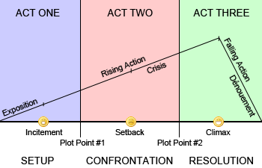
Basic Narrative Structure
No matter what the shape of the story is, it always follows this structure.
Where differences occur purely lie in what form the story takes, and in what order or manner the author chooses to present these elements.

Slide 17
起 承 轉 結

Slide 18
Linear Narrative

Slide 19
Non-Linear Narrative
Events are told out of chronological order, or in a way that deviates from the standard chronological narrative structure, instead utilizing some other version of the structure to put the pieces together.

Slide 20
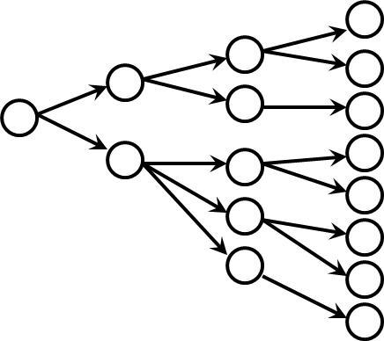
Branching Narrative
One start, many different outcomes.

Slide 21
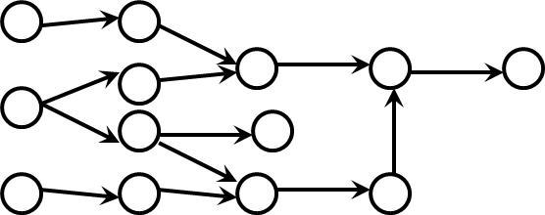
Threaded Narrative
Lots of different plot paths eventually find their way to a single, unavoidable conclusion.

Slide 22
Tell us YOUR story

Slide 23
Storytelling Exercise (part 1)
Prepare to tell a short story (1 - 3 minutes) about yourself.
You can introduce yourself to class and talk generally about what kind of person you are. What do you like to do in your free time? What are your interests and hobbies? You can also talk about a specific meaningful or interesting experience you have had.
Think of this exercise as telling a short verbal autobiography.

Slide 24
HOW do you tell the story?

Slide 25
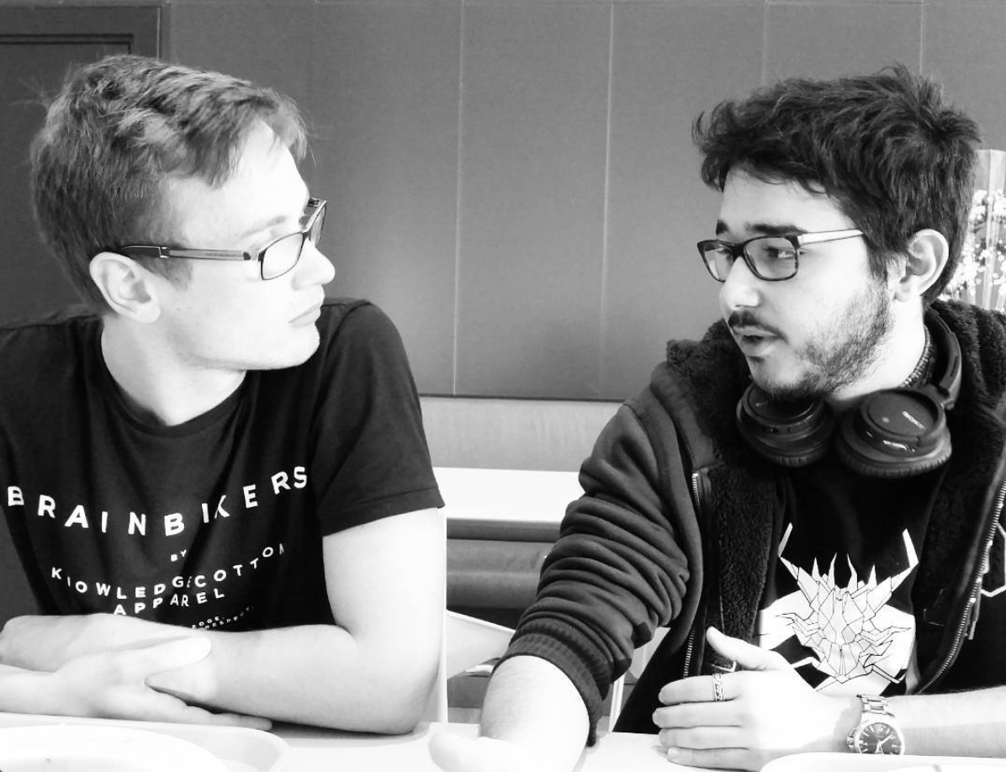
Verbal / Oral Storytelling
Photo Credit: @godnara35

Slide 26

Books (Written Storytelling)
Photo Credit: AARP

Slide 27
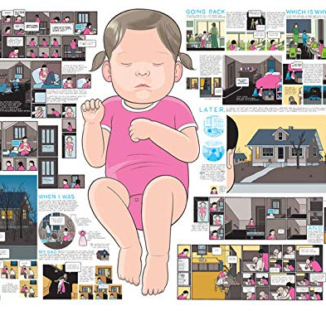
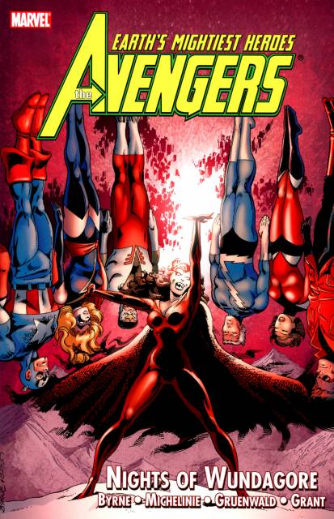
Graphic Novels (Written / Visual Storytelling)
Building Stories, Chris Ware (Photo Credit: Amazon.com)
The Avengers, Marvel (Photo Credit: Comic Vine)

Slide 28
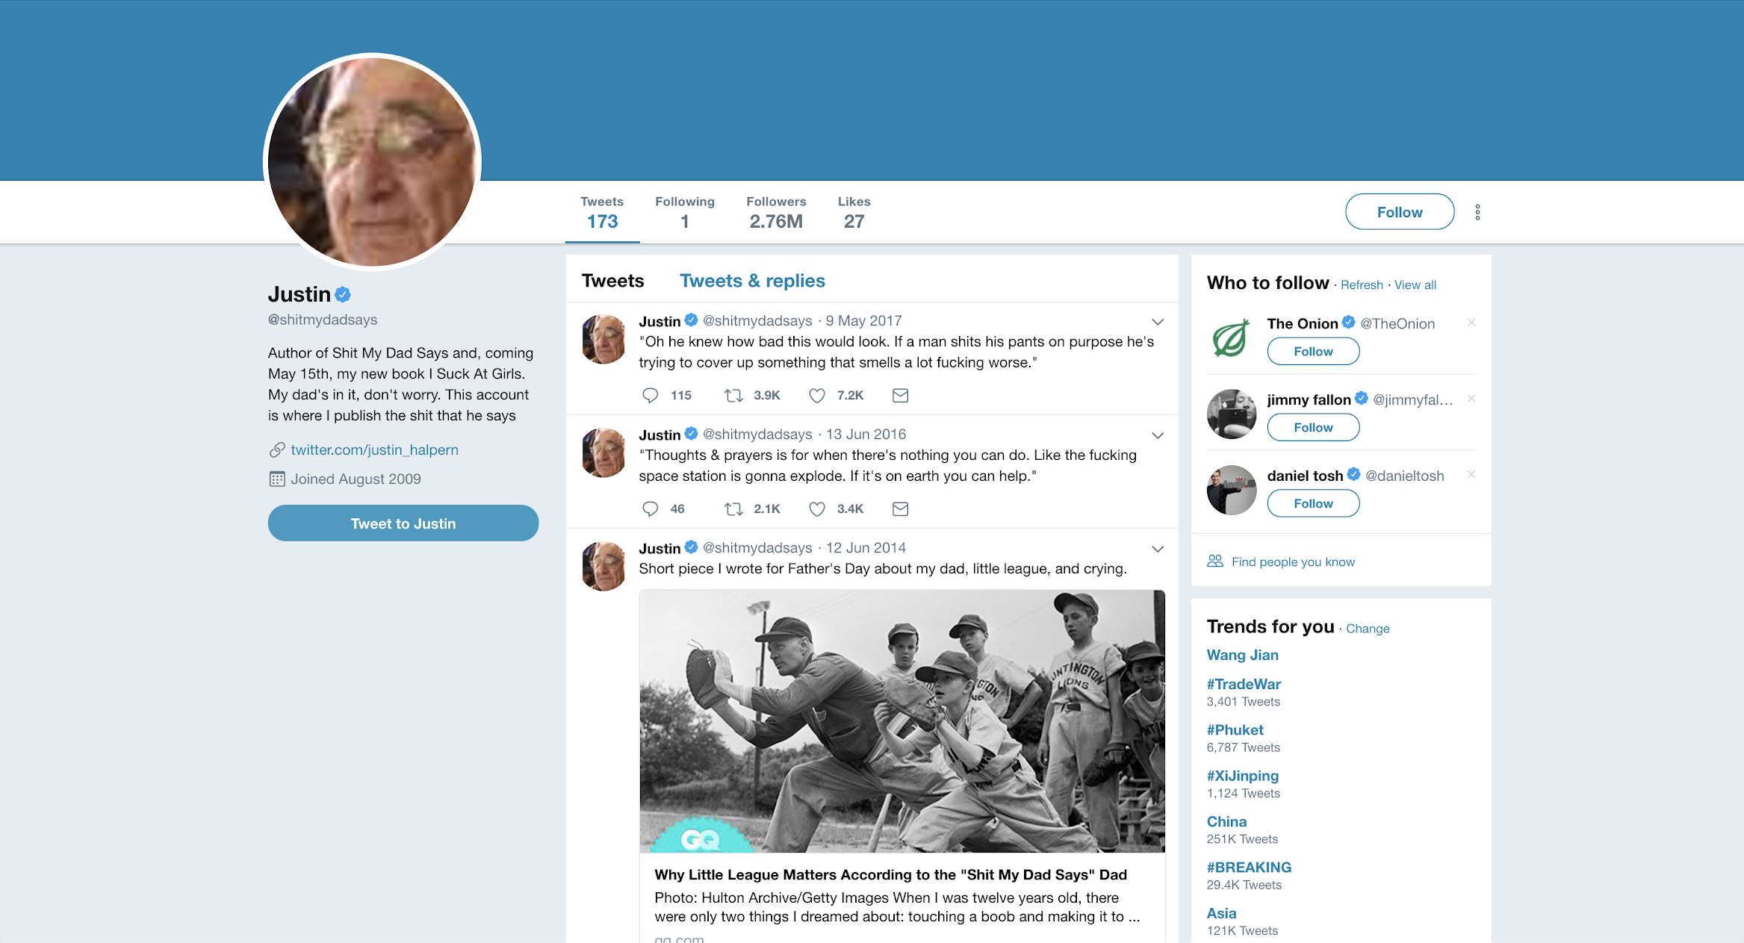
Social Media (Written Storytelling)
@shitmydadsays

Slide 29
Digital FILMMAKING

Slide 30
History of Film & Video

Slide 31
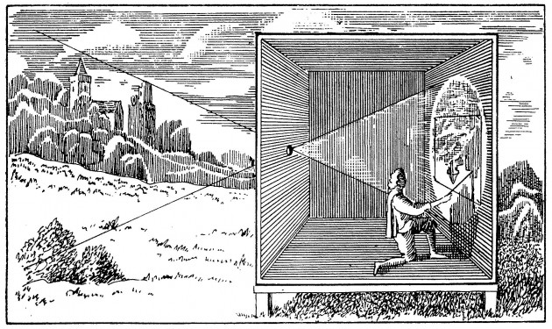
Pinhole Image
As light travels, the lit objects reflect the rays of light at the same angle but in the opposite direction.
Which explains why they appear upside down inside the camera obscura.
This is how film cameras work. The aperture is how large the hole is that lets in light.

Slide 32

Zoe Leonard

Slide 33
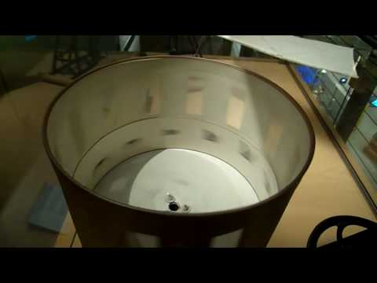
Zoetrope
Other early mechanical inventions work on the persistence of vision. The illusion of movement in an optical illusion, where we see movement in between the series of still images flashing faster than a certain rate.

Slide 34
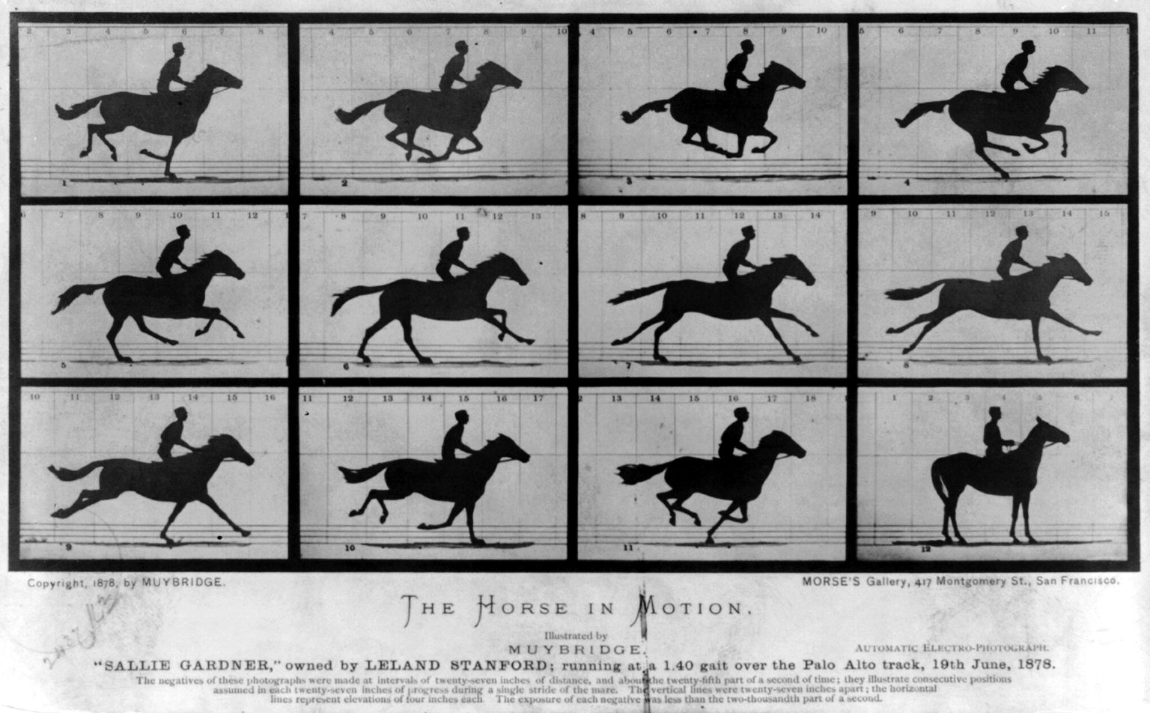
The Horse In Motion
Multiple cameras shooting a horse in motion Eadweard Muybridge (1870) used multiple cameras to capture a horse in motion. The result is a sequential narrative depicted by still images.

Slide 35
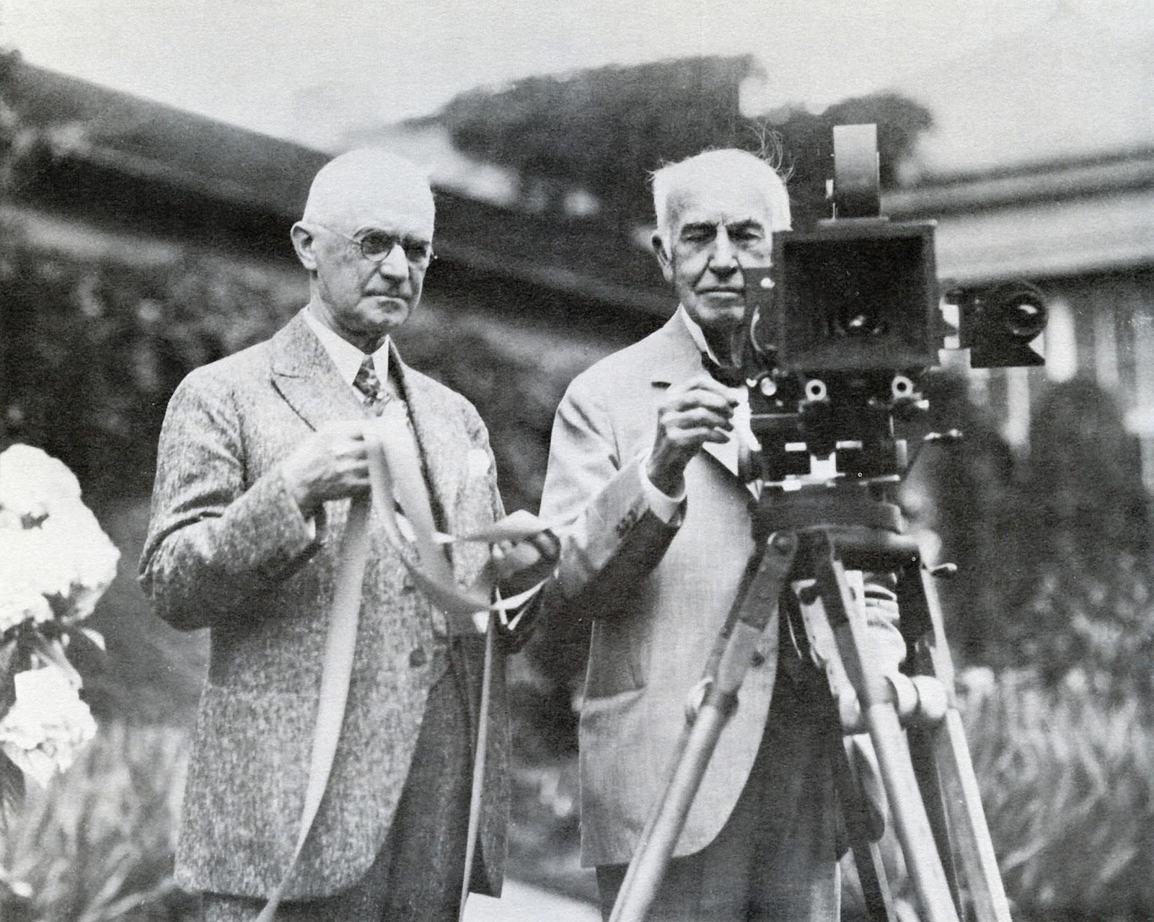
Films in the early stages
1889, first commercial roll of film is produced, leading to Thomas Edison’s motion picture camera in 1891

Slide 36
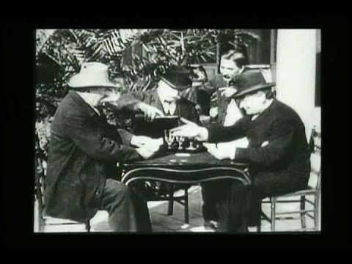
Lumiere Brothers
First Films (1895)
Considered the first filmmakers.
Their film “Exit from the Lumiere Factory” is considered the first motion picture ever made.

Slide 37
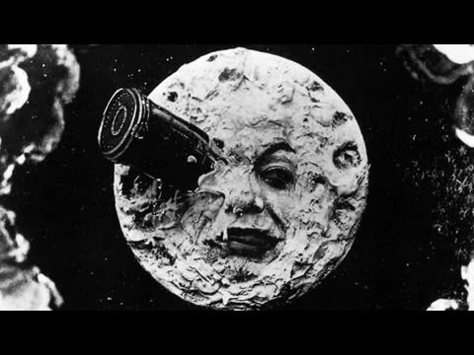
Georges Méliès
A Trip to the Moon (1902)
He was one of the earliest pioneers, experimenting with time-lapse photography, special effects, multiple exposures and more.
He was also one of the first filmmakers to use storyboards.

Slide 38
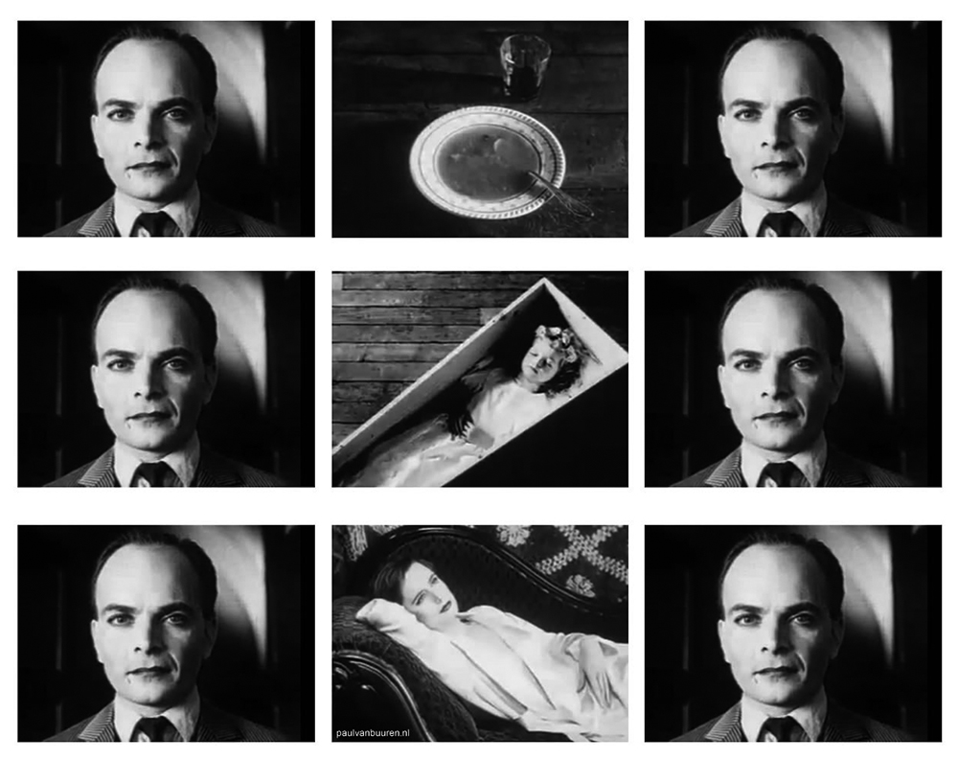
The Kuleshov Effect
Demonstrates the effectiveness of film editing to convey a meaning.
This emphasizes the importance of arrangement and assembling to create narratives.
Also known as Montage Theory.

Slide 39
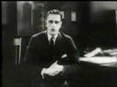
The Golden Era
The introduction of sound in the 1920s popularized the medium and turned film into a big industry.
Hollywood’s “golden era” begins in 1927, with the film industry centered around the studio system.

Slide 40
The Studio System (1920s)
Development: Script, story outline
Pre-Production :
Budget, storyboards, art department, actors cast, sets built
Production:
Filming, dailies, blocking, script continuity
Post-Production:
Development, editing, processing film

Slide 41
Rise of the Auteur (1960s)
The Studio system dominates until 1960 when further technological innovation allows films to be shot on location and smaller budgets and crews.
Auteur - a filmmaker, the film becomes representative of him.
Antonioni, Truffaut, Godard, Kurosawa, Agnes Varda,
Claire Denis, Yasujiro Ozu, Hou Hsiao Hsien, Edward Yang

Slide 42
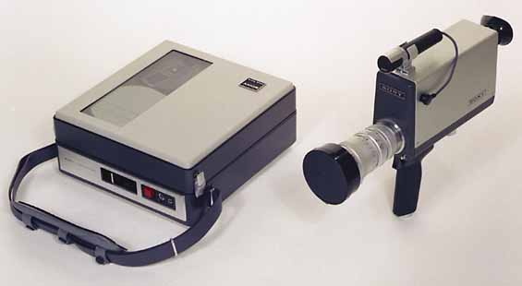
Portapak
The first handheld video camera released by Sony in 1967.
Inaugurated the modern era of video. Suddenly, it became much more inexpensive and accessible to produce movies and television.
Notes:
1967: Sony releases the Portapak (the first handheld video camera), ushering in the era of digital video. Suddenly, it became much more inexpensive and accessible to produce movies and television, and the industry has been shifting towards digital ever since.
In 1967, Sony releases the Portapak, a commercial, portable video recorder. Compared with what we have today, it is still incredibly bulky and heavy and expensive, but it allowed filmmakers to work out of the studio and inaugurated the modern era of video.
It was adopted by both professionals and amateurs and greatly influenced the development of video art, guerrilla television and activism through video.

Slide 43
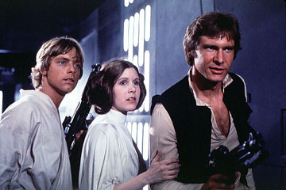
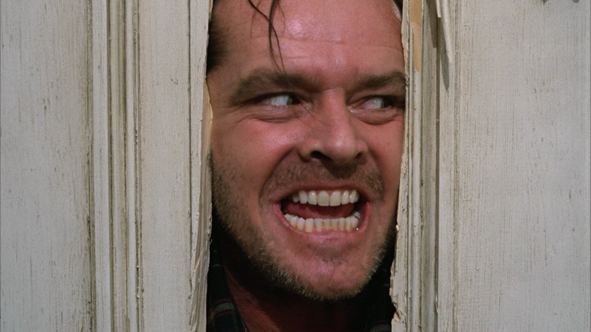
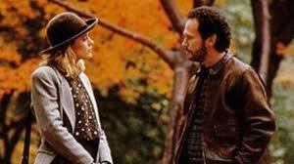
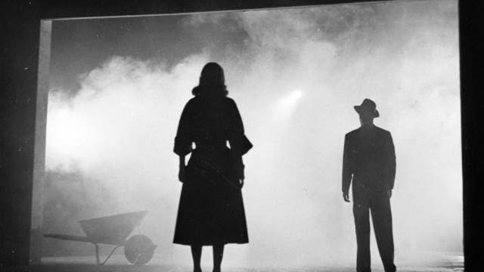
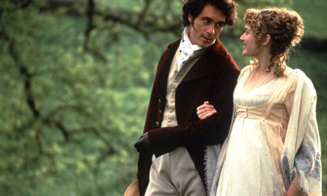
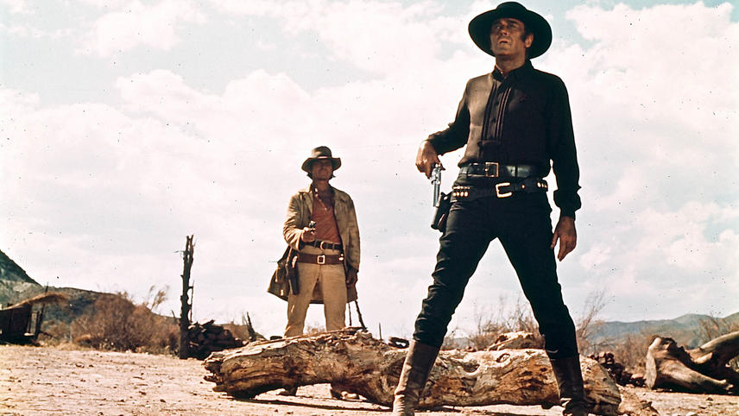
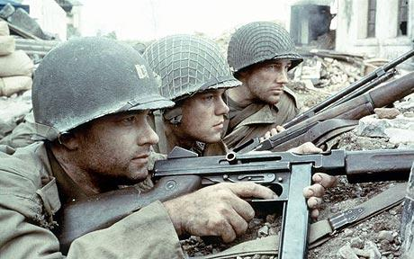
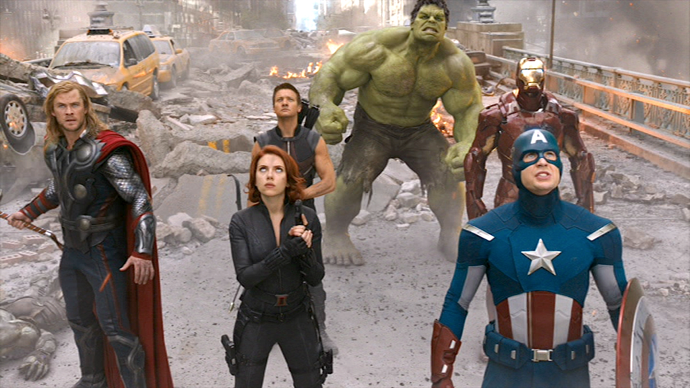
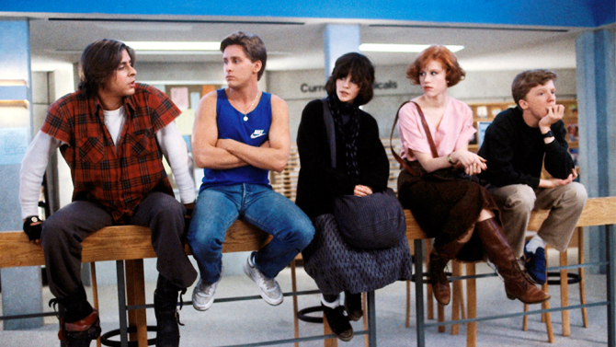
Genre Films
Films that adhere to very specific conventions of a type of storytelling.
These can be as simple as comedy, drama, etc., or more specific such as sci-fi, horror, rom-com, film noir, period drama, western, war epic, superhero/comic book film, teen movie, just to name a few.
These genres can also be hybridized.
Notes:
films that adhere to very specific conventions of a type of storytelling.
These can be as simple as comedy, drama, etc., or they can be super specific. Sci fi, horror, rom com, film noir, period drama, western, war epic, superhero/comic book film, teen movie, just to name a few. These genres can also be hybridized.

Slide 44
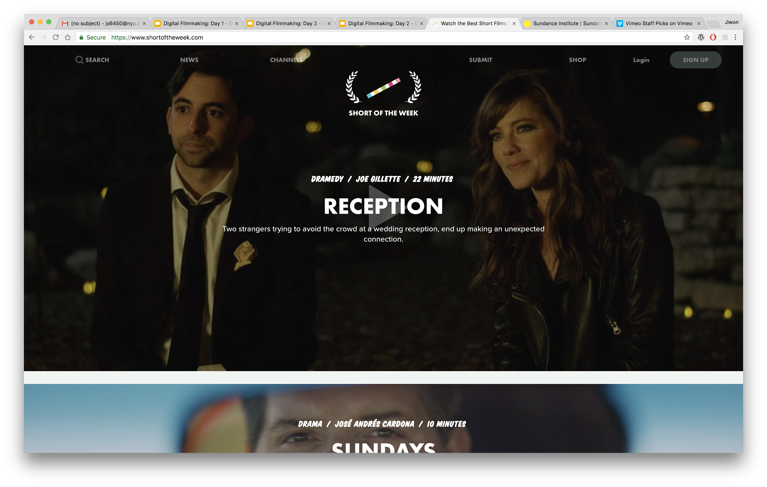
Short of The Week

Slide 45
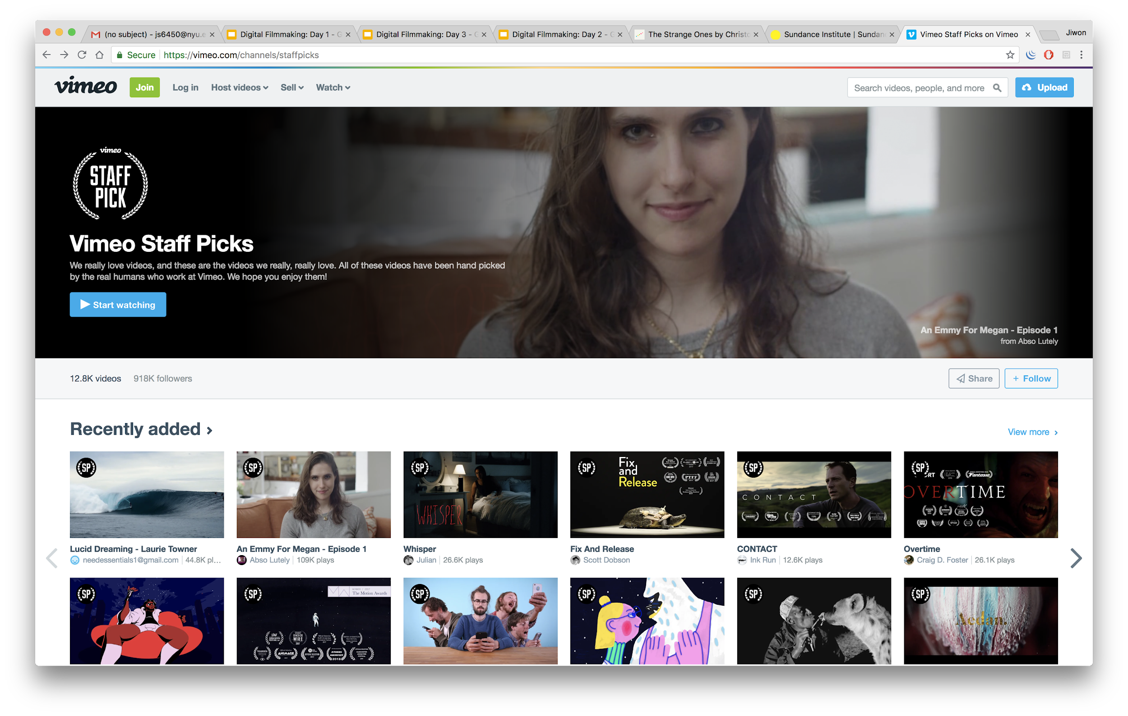
Vimeo’s Staff Picks

Slide 46
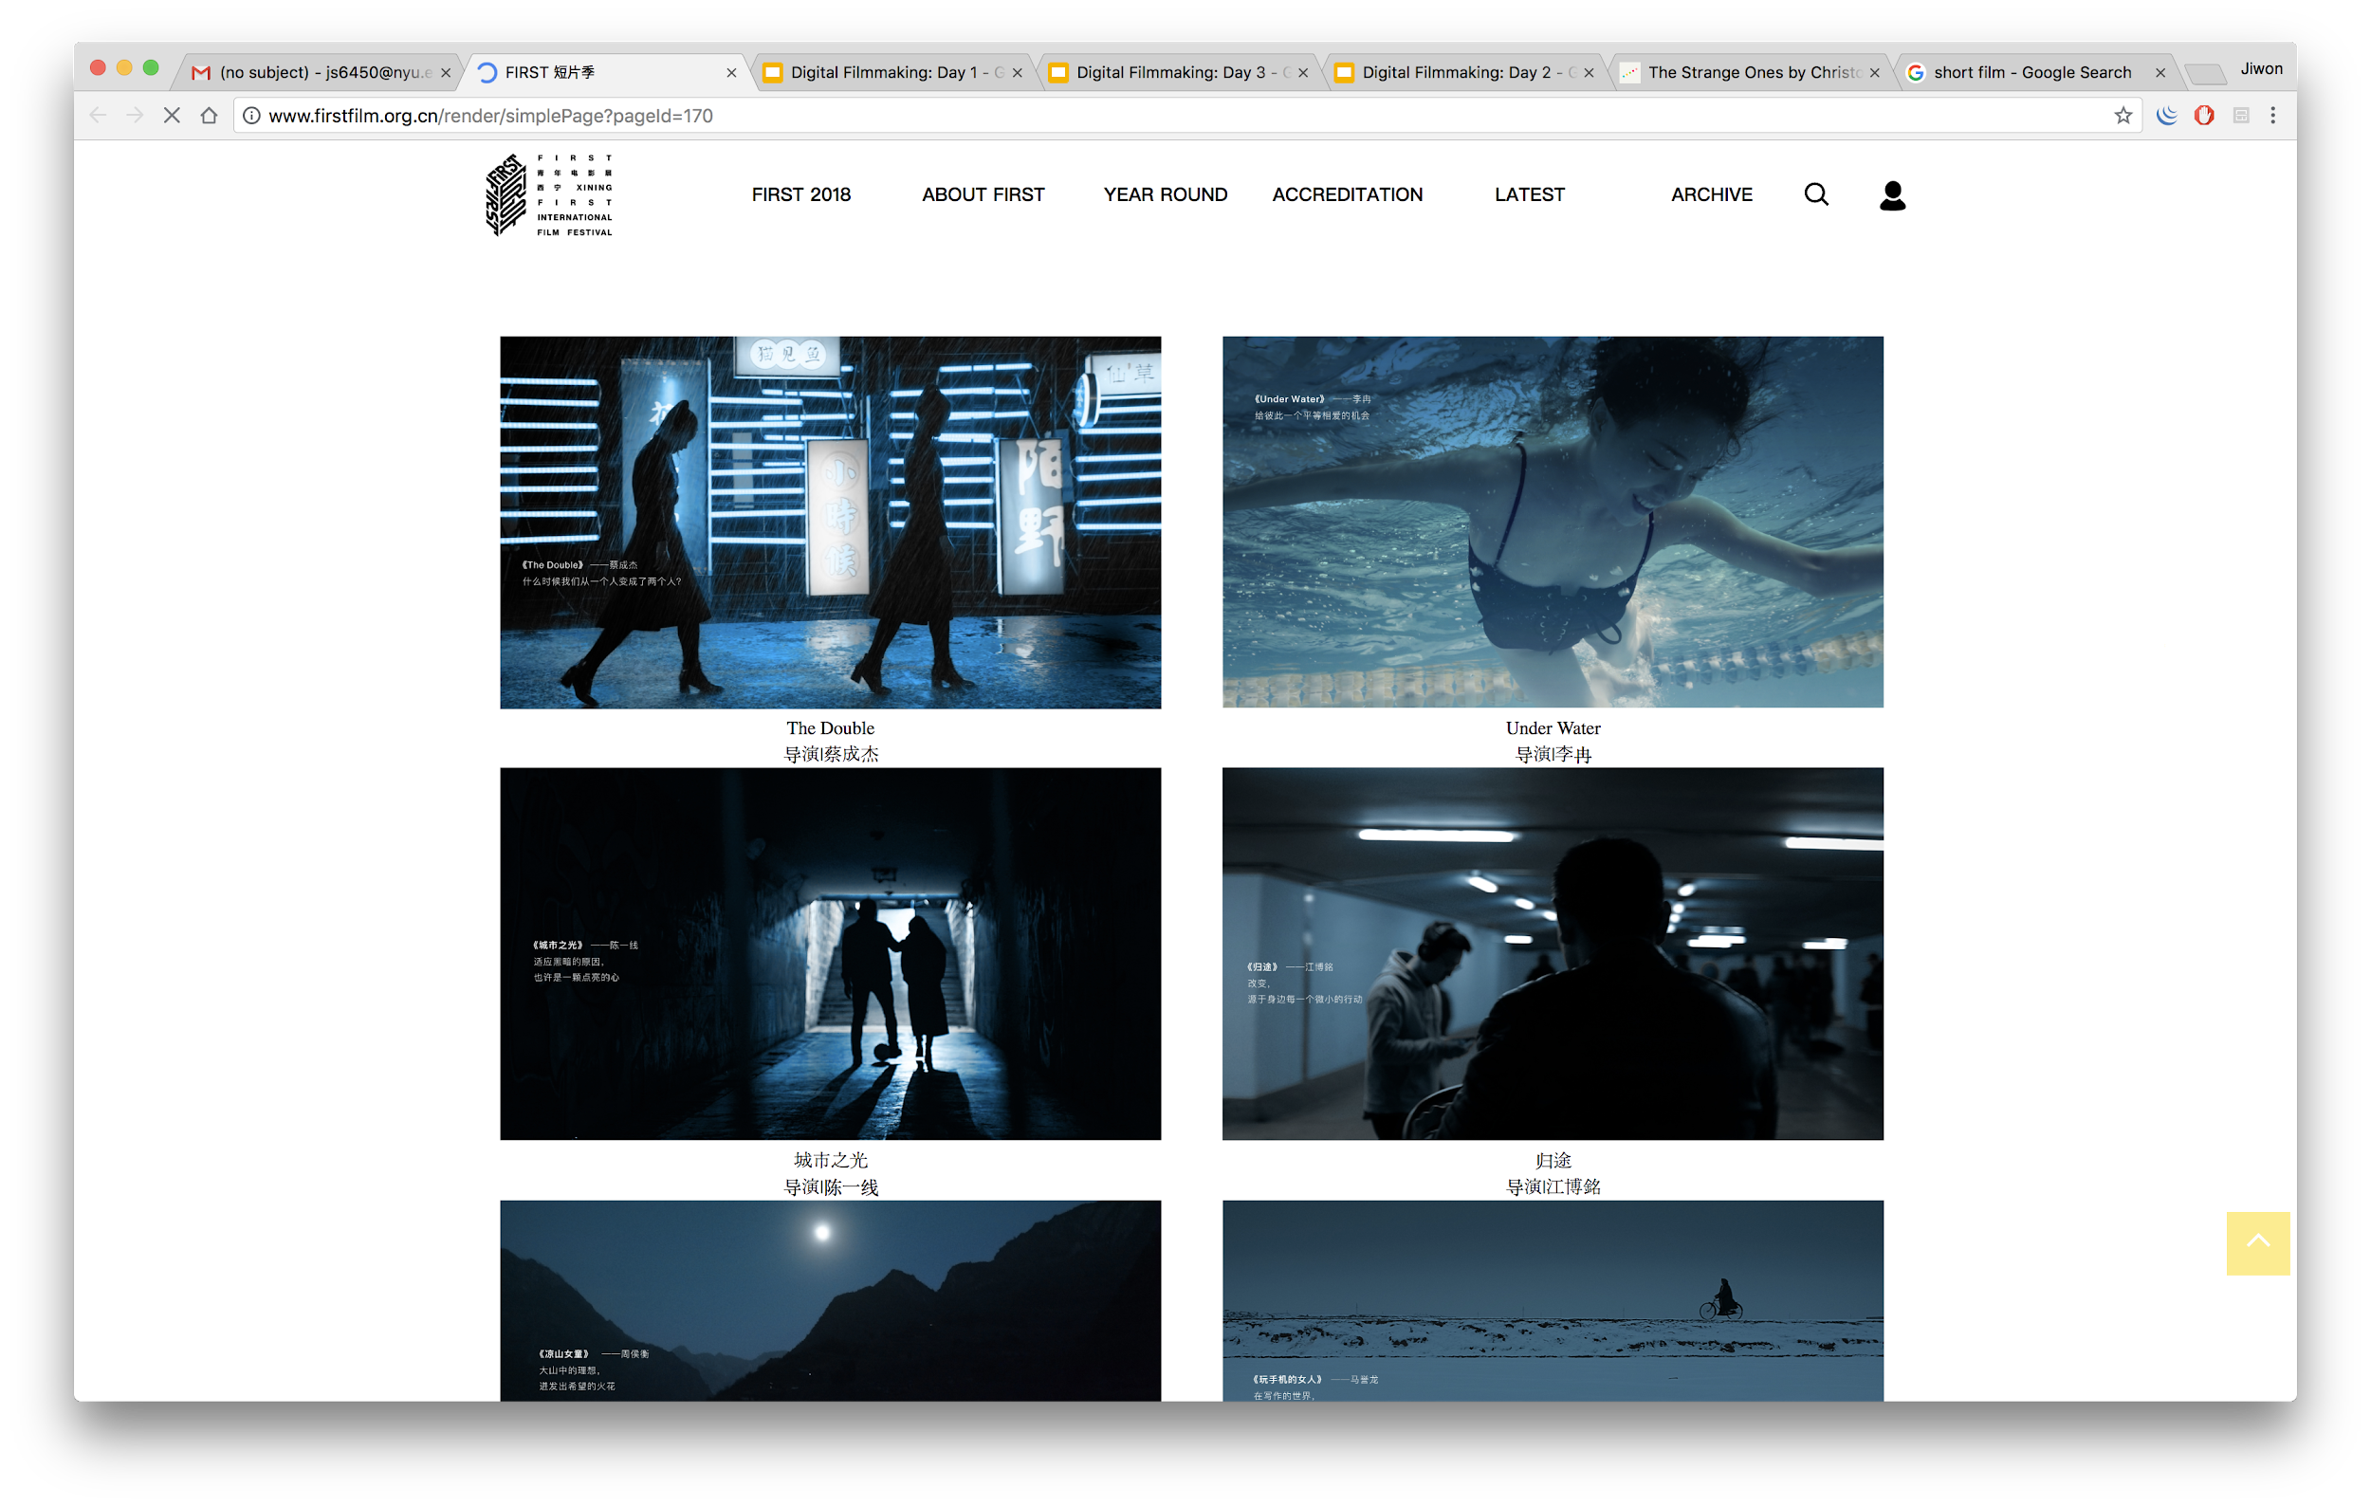
FIRST International Film Festival

Slide 47
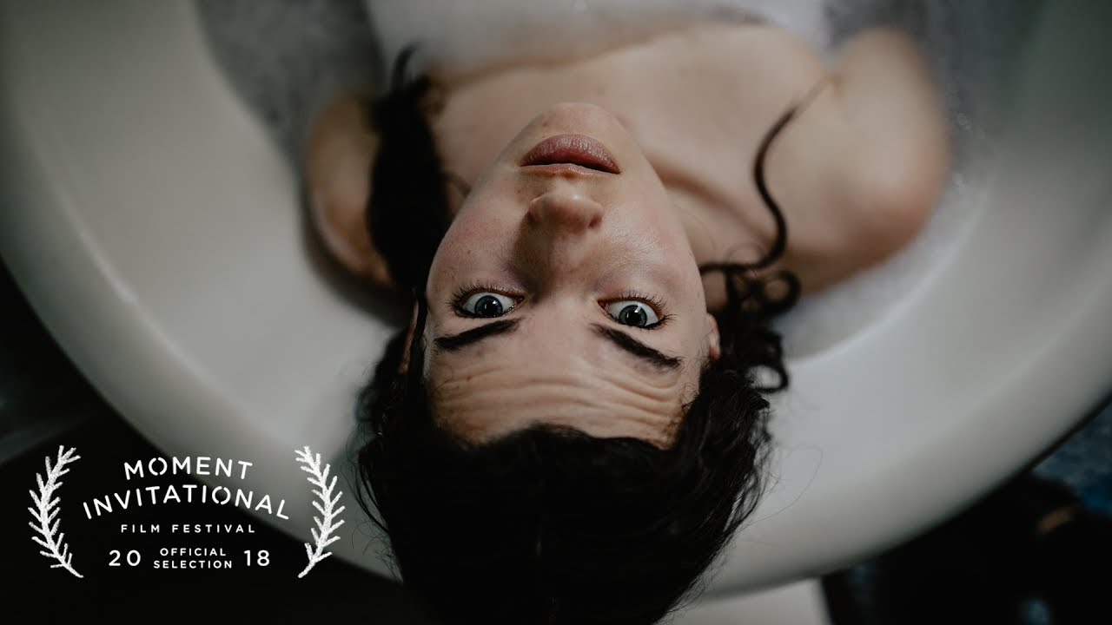
Make Sure You’re Missed, Mango Street

Slide 48
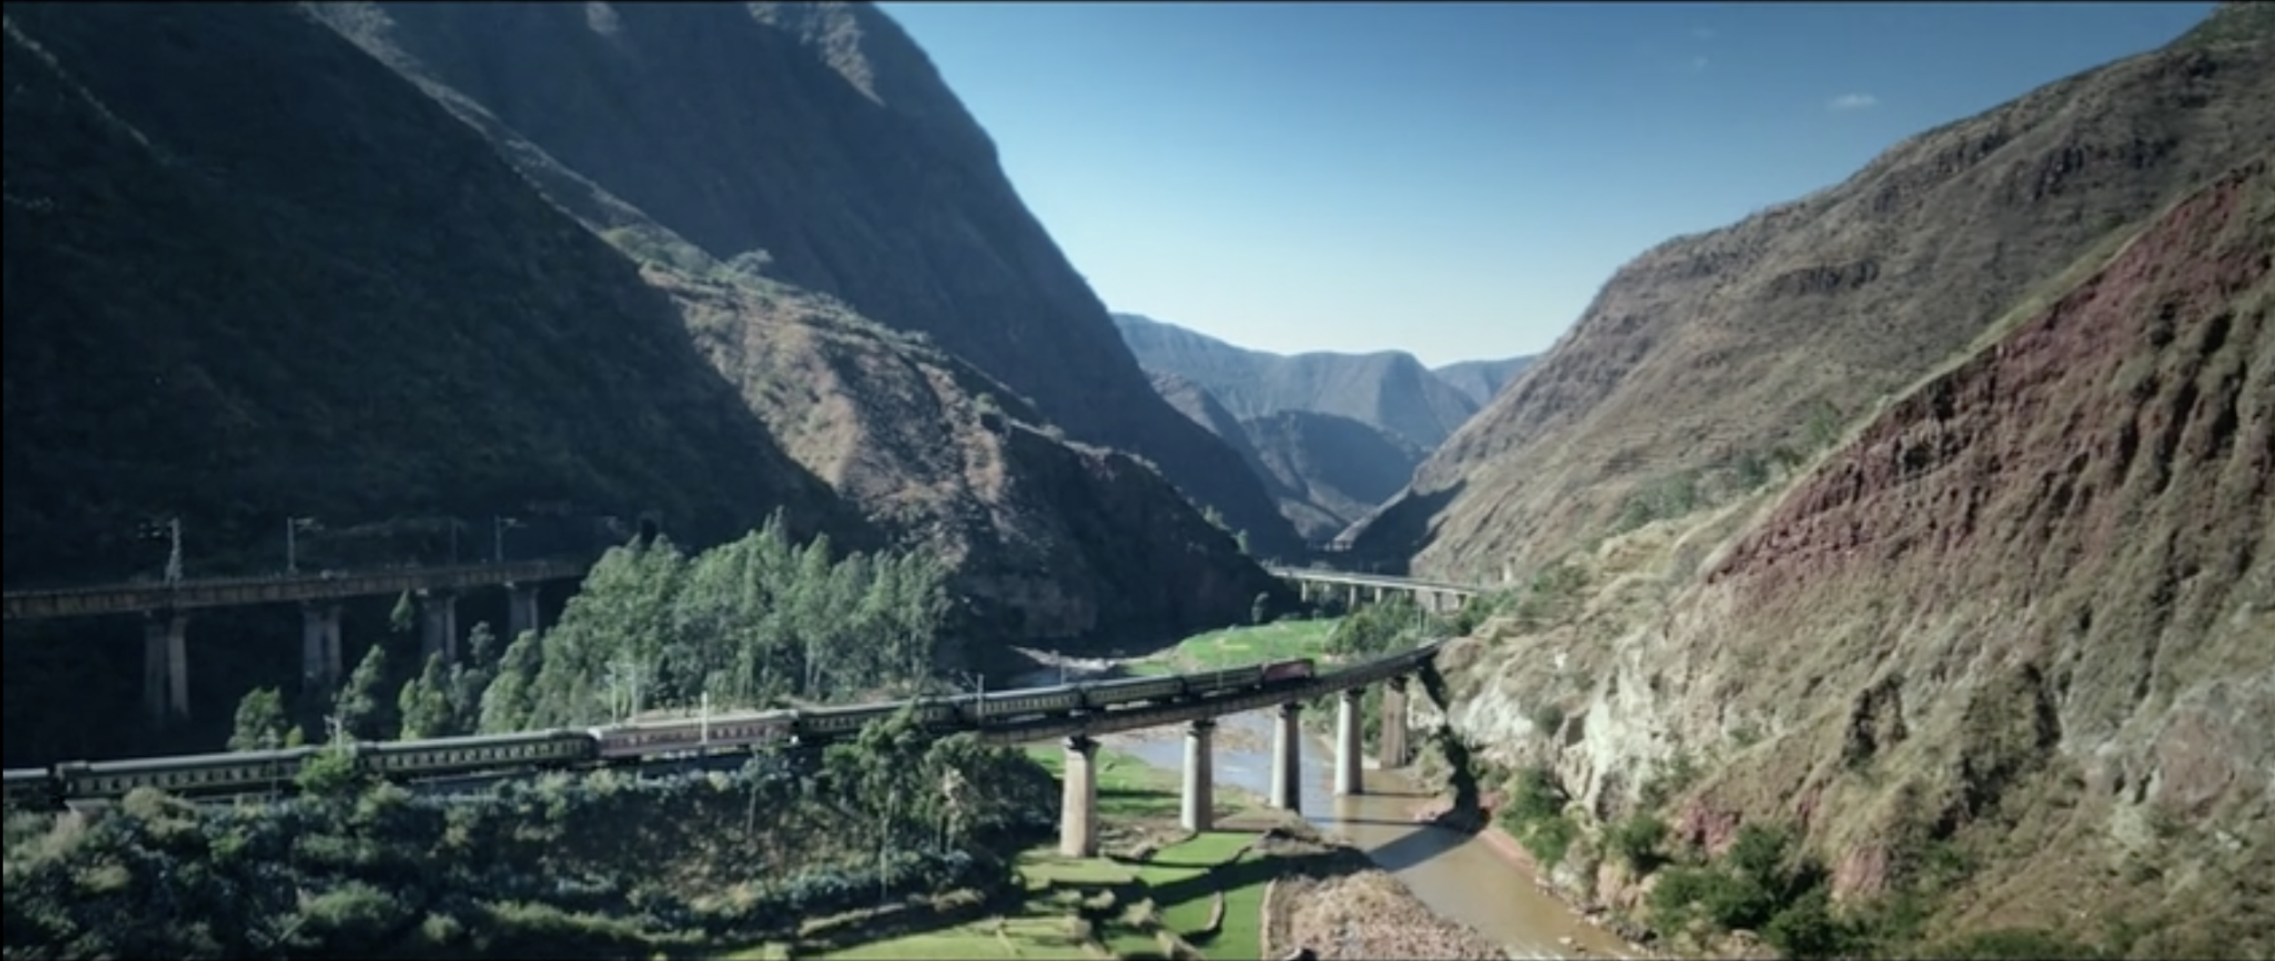
《三分钟》陈可辛导演短篇作品

Slide 49
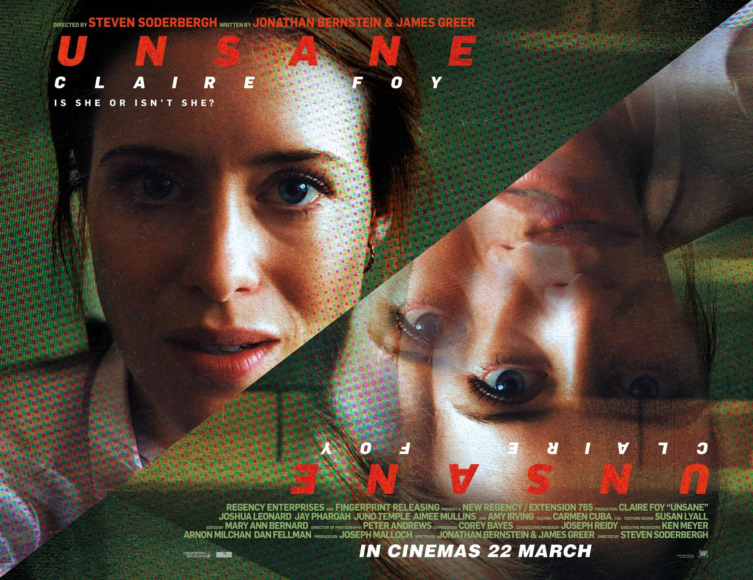
Unsane (2018), Steven Soderbergh

Slide 50
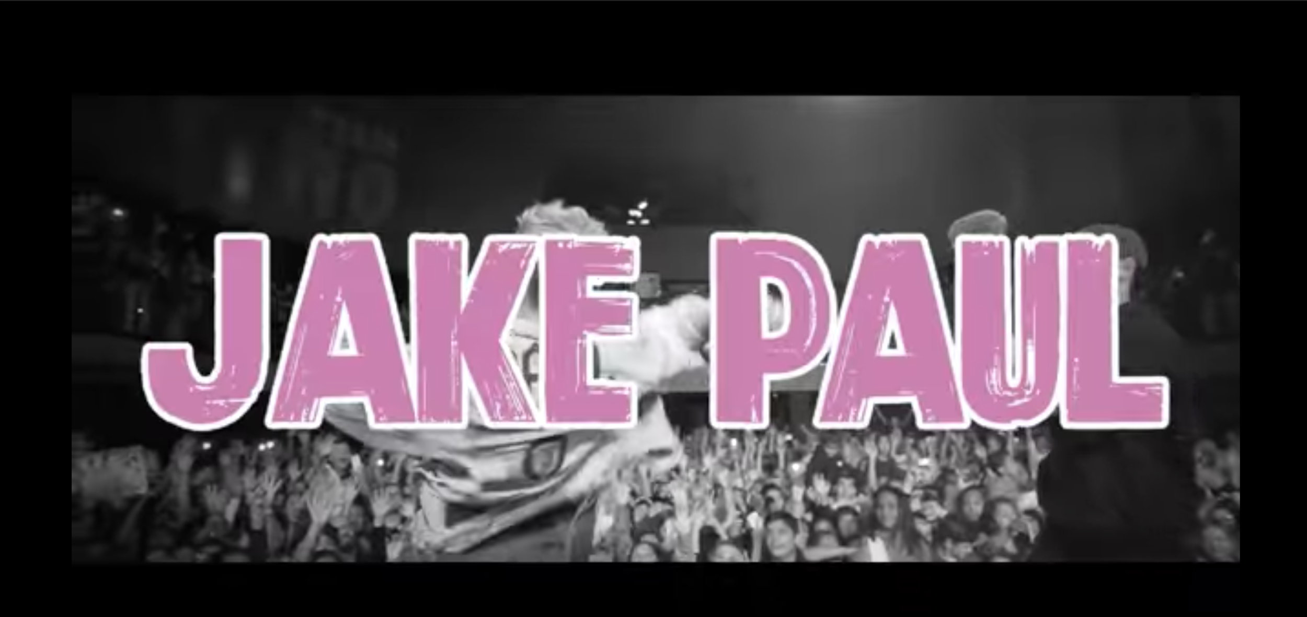
This is Jake Paul, Jake Paul

Slide 51
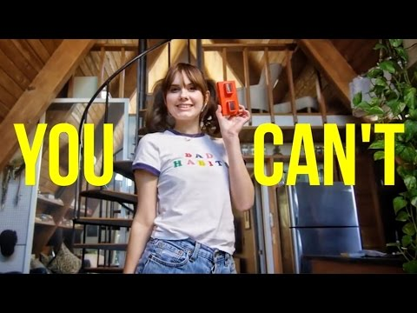
Do What You Can’t, Casey Neistat

Slide 52
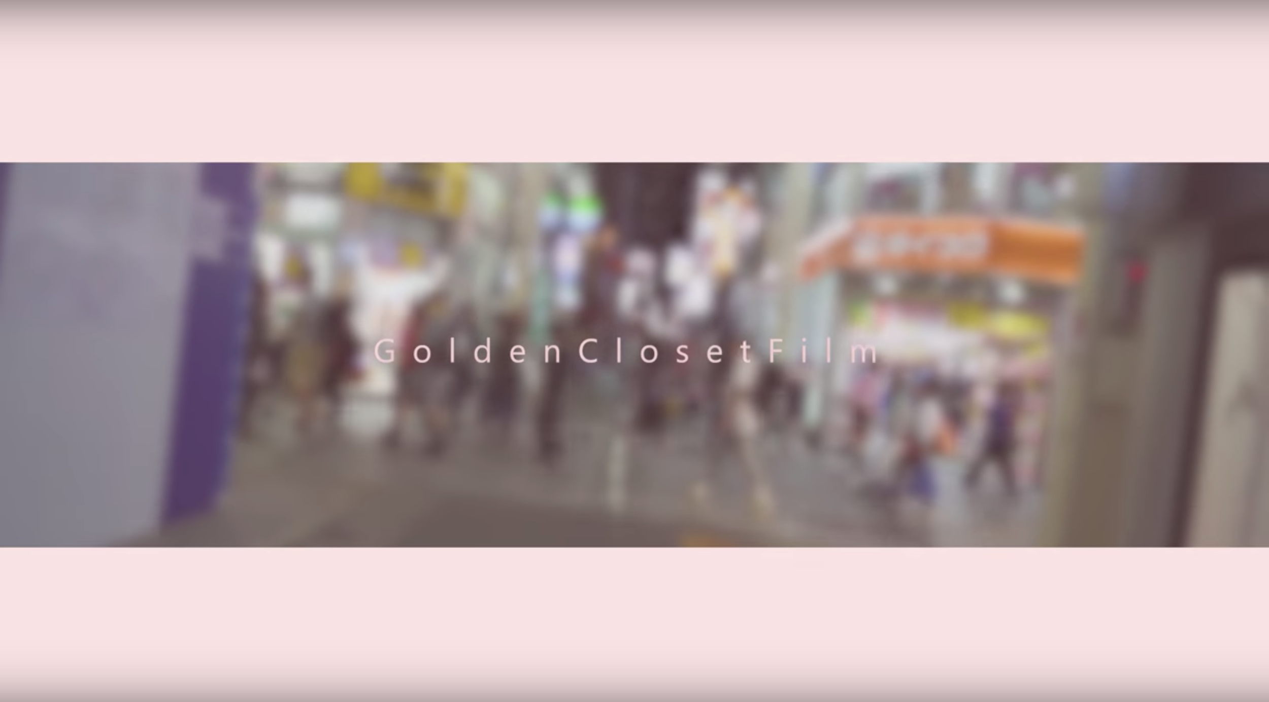

Slide 53

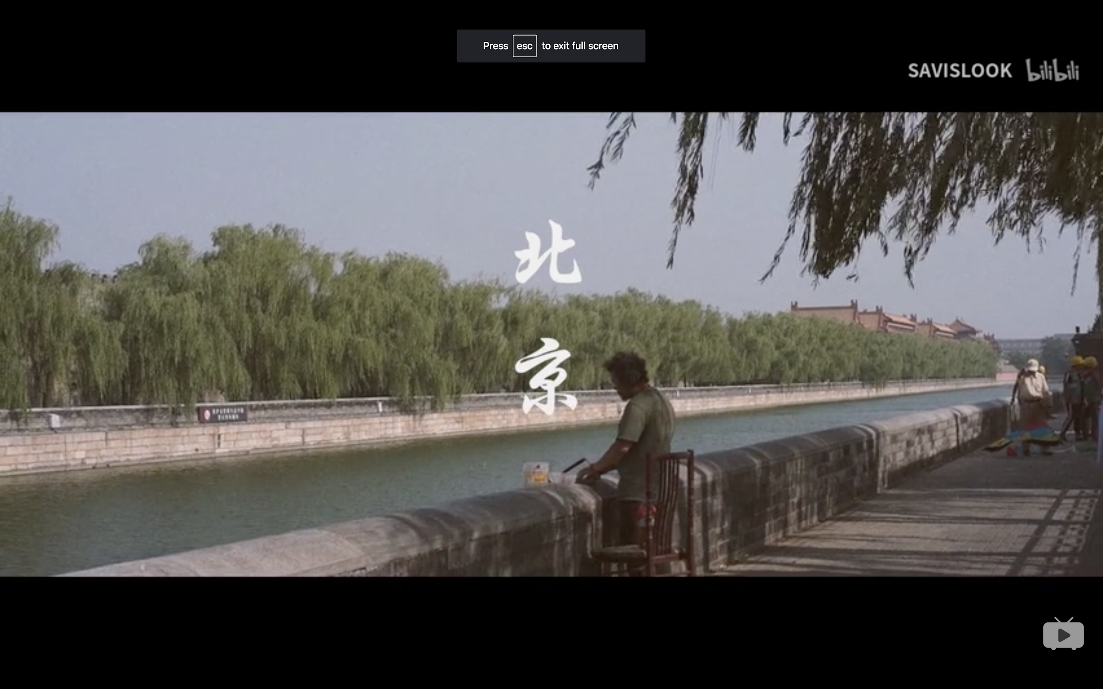

Slide 54
Storytelling Exercise (part 2)
Tell your story that you told for the Storytelling Exercise (part 1) through a video. The video version of your story can be as detailed, abstract or literal as you want.
Create the video ONLY using your mobile phone.
This means you will be recording your footage on your mobile phone as well as editing your recorded footage.

Slide 55
Storytelling Exercise (part 2)
Recommended video editor apps:
For iPhone:
Splice
iMovie
Videorama
For Android:
Viva Video
KineMaster

Slide 56
Storytelling Exercise (part 2)
Upload your finished video to YOUKU (or other online video platform of your choice).
Email your instructor (jiwon.shin@nyu.edu) with the link by 4pm.

